Slide 1
Topical Review 5
Experiments, Probability, Decisions, Classification & Classifiers

Slide 2
Experiments

Slide 3
Experiments
Goal: to find a relationship (association) between a treatment and an outcome
To make sure the treatment group and control group are similar, we randomize subjects into each group.
Observational studies: only involve looking at existing data, not generating the data by applying a treatment
Since we can’t control which individuals get the treatment, we don’t know what else (confounding factors) impacts the outcome, and thus we can’t conclude causality.

Slide 4
Practice Problem - Experiments
You have been studying frogs in a Northern Californian county and notice that, in certain ponds, an alarming number of frogs have six legs. The ponds are downstream of a factory that produces a known pollutant, Chemical X. The factory claims to safely dispose of all the contaminant, but you believe that Chemical X is, in fact, causing the sudden existence of six-legged frogs in ponds near the factory.
You decide to conduct a series of experiments to determine what’s going on!

Slide 5



Practice Problem - Experiments
How could you confidently establish whether or not the chemical was causing the frogs to have six legs?

Slide 6
Practice Problem - Experiments
How could you confidently establish whether or not the chemical was causing the frogs to have six legs?
Perform a RCT (Randomized Control Trial)
Raise frogs in controlled environments to eliminate confounding factors
Everything is the same except for the presence/absence of Chemical X
Only difference is Chemical X, so we can claim that Chemical X causes any differences we see

Slide 7
Practice Problem - Experiments
Although a randomized controlled trial (the experiment setup which we just described) would be ideal, sometimes they aren’t possible. For example, you might not have access to Chemical X, or decide that treating frogs with a known pollutant is unethical.

Slide 8
Practice Problem - Experiments
Suppose we find out Chemical X causes six-legged frogs, but we can’t directly measure the level of Chemical X in ponds. :(
The factory claims to safely dispose of all of the Chemical X that it produces, so the ponds downstream of the factory should not have any more Chemical X than the ponds upstream. Propose a null and alternative hypotheses to test this claim.

Slide 9
Practice Problem - Experiments
The factory claims to safely dispose of all of the Chemical X that it produces, and so the ponds downstream of the factory do not have any more Chemical X than the ponds upstream. Propose a null and alternative hypotheses to test this claim.
Null hypothesis: the proportion of six-legged frogs in ponds downstream of the factory is no different from the proportion in ponds upstream.
Alternative hypothesis: the proportion of six-legged frogs in ponds downstream of the factory is greater than the proportion in ponds upstream.

Slide 10
Practice Problem - Experiments
Describe the specific steps you would take to test this claim.
(Hint: What kind of test is this? What test statistic would you use for this test?)

Slide 11
Practice Problem - Experiments
Describe the specific steps you would take to test this claim. (Hint: What kind of test is this?)
Test Type: A/B test between the ponds which are either:
A: downstream of the factory
B: upstream of the factory
Test statistic: Difference in proportions of six-legged frogs in downstream ponds and upstream ponds
We can then put the data in a table and shuffle the labels (“downstream” vs. “upstream”) to conduct a permutation test.
Notes:
When we perform an AB test, we can either shuffle the data or label.
Our null hypothesis states that there is no difference
If we are shuffling the labels, we are saying that it doesn’t matter what the labels, so the difference would be the same

Slide 12
Probability

Slide 13
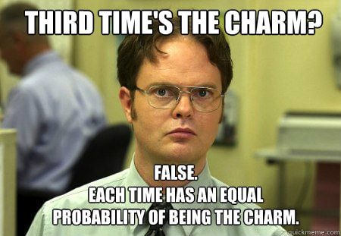
Definition of Probability
Takes on the range [0,1] (0% to 100%)
P(event) =
Number of outcomes where event occurs
-----------------------------------------------
Total number of outcomes
*Provided all outcomes are equally likely*

Slide 14
The Multiplication Rule
When two events must both happen (but they don’t affect the chance of each other happening)
P(both A & B happen) = P(A happens) x P(B happens)
If I flip a coin three times, what is the probability I get 3 heads?
Notes:
Keep in mind that this is only true for two events that are independent of each other Textbook 9.5: “Thus, when there are two conditions – one event must happen, as well as another – the chance is a fraction of a fraction, which is smaller than either of the two component fractions. The more conditions that have to be satisfied, the less likely they are to all be satisfied.”

Slide 15
The Multiplication Rule
When two events must both happen (but they don’t affect the chance of each other happening)
P(both A & B happen) = P(A happens) x P(B happens)
If I flip a coin three times, what is the probability I get 3 heads?
P(3 Heads) = P(H) * P(H) * P(H) = (½) * (½) * (½)
Notes:
Because on coin toss doesn’t affect another coin toss

Slide 16
The Addition Rule
When an event can happen in more than one way:
P(event) = P(first way) + P(second way) + …
If I flip a coin three times, what is the probability I get exactly 1 Head?

Slide 17
The Addition Rule
When an event can happen in more than one way:
P(event) = P(first way) + P(second way) + …
If I flip a coin three times, what is the probability I get exactly 1 Head?
P(exactly 1 Head) = P(HTT) + P(THT) + P(TTH)
= (½)(½)(½) + (½)(½)(½) + (½)(½)(½)

Slide 18
With vs. Without Replacement
When we sample with replacement, one event does not affect another (independence).
When we sample without replacement, one event can affect another (dependence).

Slide 19
With vs. Without Replacement
Example: We have 4 blue marbles and 5 red marbles.
What is the probability that if I draw two marbles with replacement I get one red marble and then one blue marble?
What about without replacement?

Slide 20
With vs. Without Replacement
Example: We have 4 blue marbles and 5 red marbles.
What is the probability that if I draw two marbles with replacement I get one red marble and then one blue marble?
What about without replacement?
With Replacement: 5/9 * 4/9
Without Replacement: 5/9 * 4/8

Slide 21
With Replacement vs. Without Replacement
With Replacement:
bootstrapping in hypothesis testing
creating confidence intervals
Without Replacement:
for permutation tests for A/B testing
shuffling data before splitting into a training and test set

Slide 22
The Complement Rule
P(event happens) = 1 - P(event doesn’t happen)
Used when calculating the ways an event could happen is difficult, and calculating the ways it doesn’t happen is simple.
If I flip a coin three times, what is the probability I get at least 1 Head?

Slide 23
The Complement Rule
P(event happens) = 1 - P(event doesn’t happen)
If I flip a coin three times, what is the probability I get at least 1 Head?
P(at least one head in 3 tosses)
= 1 - P(none of the 3 tosses are heads)
= 1 - P(all 3 tosses are tails)
= 1 - (½)(½)(½)

Slide 24
Probability Rules
The three rules we learned so far:
Multiplication Rule: P(A and B) = P(A)*P(B)
Addition Rule: P(A or B) = P(A) + P(B)
Complement Rule: P(A) = 1 - P(not A)

Slide 25

Bayes’ Rule Intro (Homework Review)
A doctor purchased 5 syringes and found 4 of them to be faulty. Assuming that there is a 1% failure rate, what is the probability of exactly 4 out of 5 syringes being faulty?

Slide 26
A doctor purchased 5 syringes and found 4 of them to be faulty. Assuming that there is a 1% failure rate, what is the probability of exactly 4 out of 5 syringes being faulty?
P(exactly 4 out of 5 syringes are faulty)
= 5 * ((0.01)*(0.01)*(0.01)*(0.01)*(0.99))
= 5 * ((0.01 ** 4) * 0.99)
(you’re using both addition and multiplication rules!)
Notes:
First, we see what’s happening inside the parentheses. There are 5 different ways to get 4 out of 5 syringes being faulty, so we must consider all of these possibilities under the addition rule. The first syringe is not faulty, the second syringe is not faulty and so on...

Slide 27
Decisions (Bayes’ Rule)

Slide 28
Decisions
Goal: Incorporate prior knowledge to make better decisions
P(A & B happen) = P(A happens)*P(B happens given A happens)
P(B & A happen) = P(B happens)*P(A happens given B happens)
Bayes Theorem:
P(A|B) = P(A & B) = P(A happens)*P(B happens given A happens)
P(B) P(B)
Bayes is just all the multiplication!
Draw a tree diagram to make things easier
P(A|B) = Probability of A,
given B happens

Slide 29

Bayes Example
The Luminar Company makes lamps in two factories: A lamps are made in factory A, and B lamps in factory B.
You, as the quality control manager, are trying to find out which factory (A or B) is producing more defective lamps.
Luminar Company makes 70% A lamps and 30% B lamps.
A lamps have a 1% chance of being defective.
B lamps have a 1.5% chance of being defective.
Notes:
https://onlinecourses.science.psu.edu/stat414/node/43

Slide 30
Bayes Example
Luminar Company makes 70% A lamps and 30% B lamps.
A lamps have a 1% chance of being defective.
B lamps have a 1.5% chance of being defective.
Draw a tree diagram to represent the data
Notes:
https://onlinecourses.science.psu.edu/stat414/node/43

Slide 31
Bayes Example
Luminar Company makes 70% A lamps and 30% B lamps.
A lamps have a 1% chance of being defective.
B lamps have a 1.5% chance of being defective.
Draw a tree diagram to represent the data
Defective
Lamp A
Not defective
Defective
Lamp B
Not defective
Notes:
https://onlinecourses.science.psu.edu/stat414/node/43

Slide 32
Bayes Example
Luminar Company makes 70% A lamps and 30% B lamps.
A lamps have a 1% chance of being defective.
B lamps have a 1.5% chance of being defective.
Draw a tree diagram to represent the data
Defective
.01
Lamp A
.99
.70
Not defective
.015
Defective
.30
Lamp B
.985
Not defective
Notes:
https://onlinecourses.science.psu.edu/stat414/node/43

Slide 33
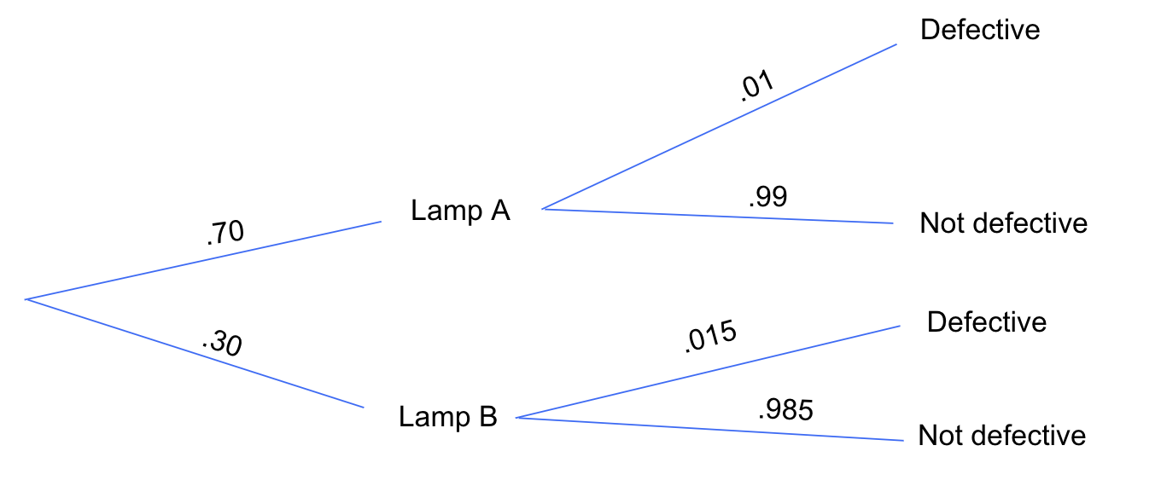
Bayes Example
.01 = P(a lamp is defective ____________________)
.99 = P(a lamp is not defective ____________________)
.70 = P(Lamp is ______)
.30 = P(Lamp is ______)

Slide 34
Bayes Example
.01 = P(a lamp is defective given the lamp is Lamp A) = P( defective | Lamp A )
.99 = P(a lamp is not defective given the lamp is Lamp A) = P( not defective | Lamp A )
.70 = P(Lamp is Lamp A)
.30 = P(Lamp is Lamp B)

Slide 35
Bayes Example
If a randomly selected lamp is defective, what is the probability that the lamp was manufactured in factory A?
P( ______ | ________ )

Slide 36
Bayes Example
If a randomly selected lamp is defective, what is the probability that the lamp was manufactured in factory A?
P( Lamp A | defective )

Slide 37
Bayes Example
P( Lamp A | defective ) = P(Lamp A) * P(Lamp is defective given Lamp A)
P(Lamp is defective)
= (.70) (.01)
(.70) (.01) + (.30) (.015)

Slide 38
Bayes Example #2
1% of a population suffers from a certain disease. A diagnostic test gives a positive indication 97% of the time when an individual has the disease, and a negative response 95% of the time when an individual doesn't have the disease.
A person selected randomly reacts positively to the test. What is the probability that this person actually has the disease? (Hint: Draw a tree diagram)

Slide 39
1% of a population suffers from a certain disease. A diagnostic test gives a positive indication 97% of the time when an individual has the disease, and a negative response 95% of the time when an individual doesn't have the disease.
+
97%
D
3%
1%
-
+
5%
99%
no D
95%
-

Slide 40
A person selected randomly reacts positively to the test. What is the probability that this person actually has the disease?
+
97%
D
3%
1%
-
+
5%
99%
no D
95%
-

Slide 41
A person selected randomly reacts positively to the test. What is the probability that this person actually has the disease?
+
97%
P(Disease | + Test Result)
= P(Disease AND +) / P(+)
P(Disease AND +) = 0.01 * 0.97
P(+) = (0.01 * 0.97) + (0.99 * 0.05)
P(Disease | + Test Result)
= 0.0097/0.0592 = 0.1638
D
3%
1%
-
+
5%
99%
no D
95%
-

Slide 42
Classification & Classifiers (K-NN)

Slide 43
Classification
Overarching goal: a classifier assigns a label (category) for new data points based on past data
Each data point has characteristic features
Binary classifiers categorize new data points into 2 categories (e.g. action vs. romance)

Slide 44
Classifiers
We must train our classifier before we can use it
Divide given data into training and testing set
Training set serves as our “past observations” to learn from
Test set allows us to see how good our model is on unseen data.
Important:
never use test set to train our classifier
must keep some data reserved to test accuracy
never use training set to test our classifier
overfitting and false accuracies

Slide 45
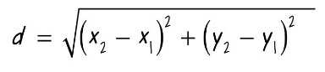
k-Nearest Neighbors
For a new data point, get k nearest neighbors and classify based on majority of neighbors’ labels
distance = np.sqrt(np.sum((feats_1 - feats_2) ** 2))
Think right triangles and Pythagorean Theorem
What happens when there’s a tie?
We can’t tell... unless we have a tie-breaking method (e.g. always categorize as default class). This is why we choose an odd k.

Slide 46
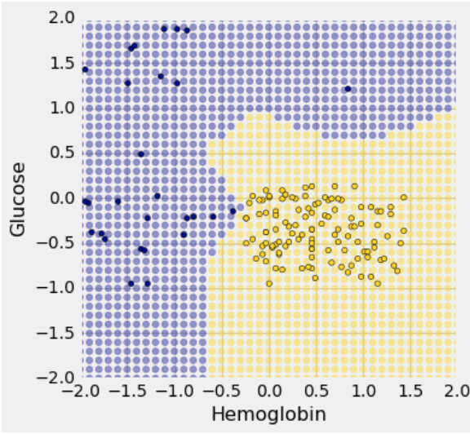
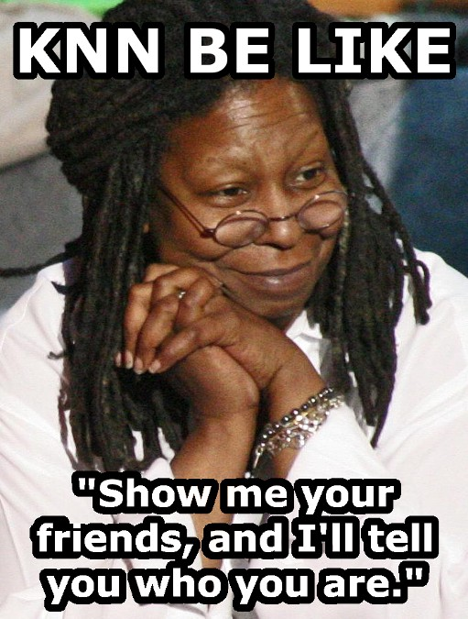
Decision Boundaries
Visualization that shows what class a data point would belong to in a KNN model (built from training set)
Ex: 1-nearest neighbor decision boundaries

Slide 47
Classification: Conceptual Questions
For any kNN classifier, what is a potential downside of using k = 4?
For any kNN classifier, what could potentially go wrong if we choose a k that is too large?

Slide 48
Classification: Conceptual Questions
For any kNN classifier, what is a potential downside of using k = 4?
For any even value of k, we could run into a tie (2 neighbors as class A and 2 as class B). To deal with this, we need a tie-breaking scheme.
For any kNN classifier, what could potentially go wrong if we choose a k that is too large?
If our training set had 10 items in class A and 20 items in class B, k = 21 or higher would make it impossible to classify anything as class A.

Slide 49
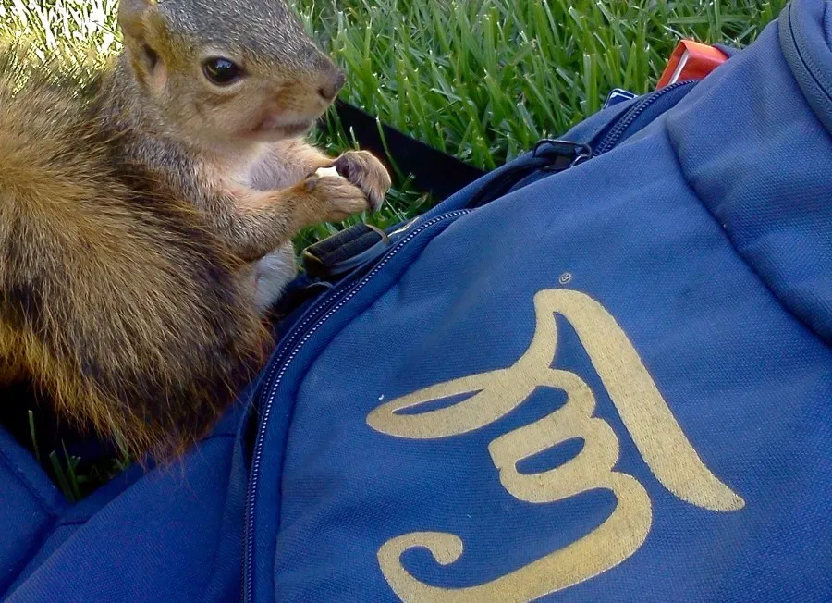
Classification:
Squirrels
(Spring 2017 Final)
Some Berkeley squirrels are wild animals and some are pets! Your friend is a squirrel expert and says that two useful features for classifying squirrels are the proportion of their fur that is clean and their weight in ounces.

Slide 50
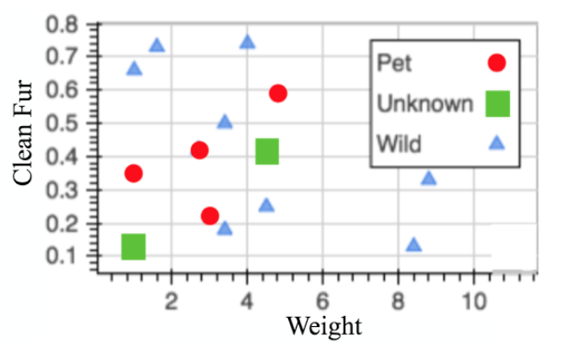
Classification:
Squirrels
(Spring 2017 Final)
2
What is the distance between squirrel 1 and its nearest neighbor?
1
Classify squirrel 2 using just the “Clean Fur” feature, then using both features.

Slide 51
Classification:
Squirrels
(Spring 2017 Final)
2
What is the distance between squirrel 1 and its nearest neighbor?
sqrt[(1-1)^2 + (.35-.1)^2] = 0.25
1
Classify squirrel 2 using just the “Clean Fur” feature, then using both features.
Clean fur: we only care about the vertical distance, so the NN is circled above, and it is a pet
Both: the horizontal distance is much bigger than the vertical, so the NN is boxed above, and it is wild

Slide 52
Classification:
Squirrels
(Spring 2017 Final)
2
Say that we got a new set of all-wild squirrels. For what value(s) of k can we classify all of these squirrels with 100% accuracy?
(Hint: there are 12 squirrels, 4 pets and 8 wild)
1

Slide 53
Classification:
Squirrels
(Spring 2017 Final)
2
Say that we got a new set of all-wild squirrels. For what value(s) of k can we classify all of these squirrels with 100% accuracy?
(Hint: there are 12 squirrels, 4 pets and 8 wild)
1
If we have a k between 9 and 12, we are always guaranteed a “wild” majority.

Slide 54
Extra Problems

Slide 55
Experiments
Identify each as an observational study or an experiment. What might potential confounding factors be in the observational studies?
Compare the math final grades of students who use graphing calculators vs. regular calculators on the exam
Determine if people who take vitamin C every day are less likely to get colds
Compare voter satisfaction between people randomly assigned to use a paper ballot vs. a touch screen machine
Notes:
Ideas sourced: http://rpdp.net/admin/images/uploads/resource_11748.pdf

Slide 56
Experiments
Compare the math final grades of students who use graphing calculators vs. regular calculators on the exam OS: Students who can afford graphing calculators may be able to afford tutoring
Determine if people who take vitamin C every day are less likely to get colds OS: People who take vitamin C daily may be more health conscious overall
Compare voter satisfaction between people randomly assigned to use a paper ballot vs. a touch screen machine Randomized controlled experiment

Slide 57
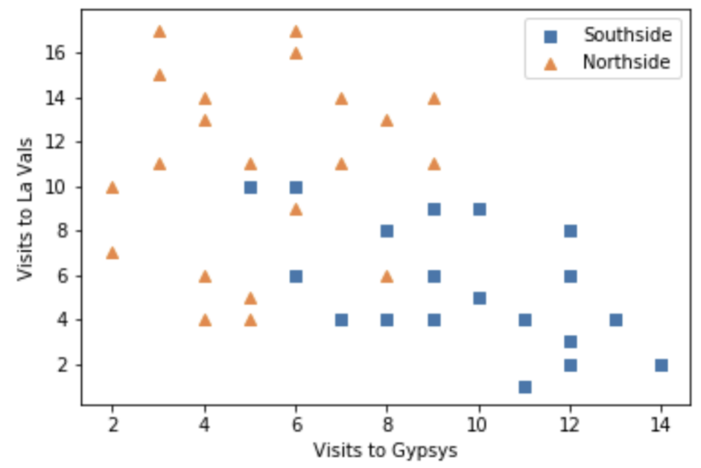
Decision Boundaries
A student is building a classifier to classify Berkeley students as residents of Northside or Southside. For each student has data on whether the student lives on Northside or Southside, the number of times the student went to La Val’s (on Northside) in the last 6 months, and the number of times the student went to Gypsy’s (on Southside) in the last 6 months. Draw a decision boundary for a 5 nearest neighbor classifier on the scatter plot below.
Notes:
Tutoring worksheet 13, fa19

Slide 58
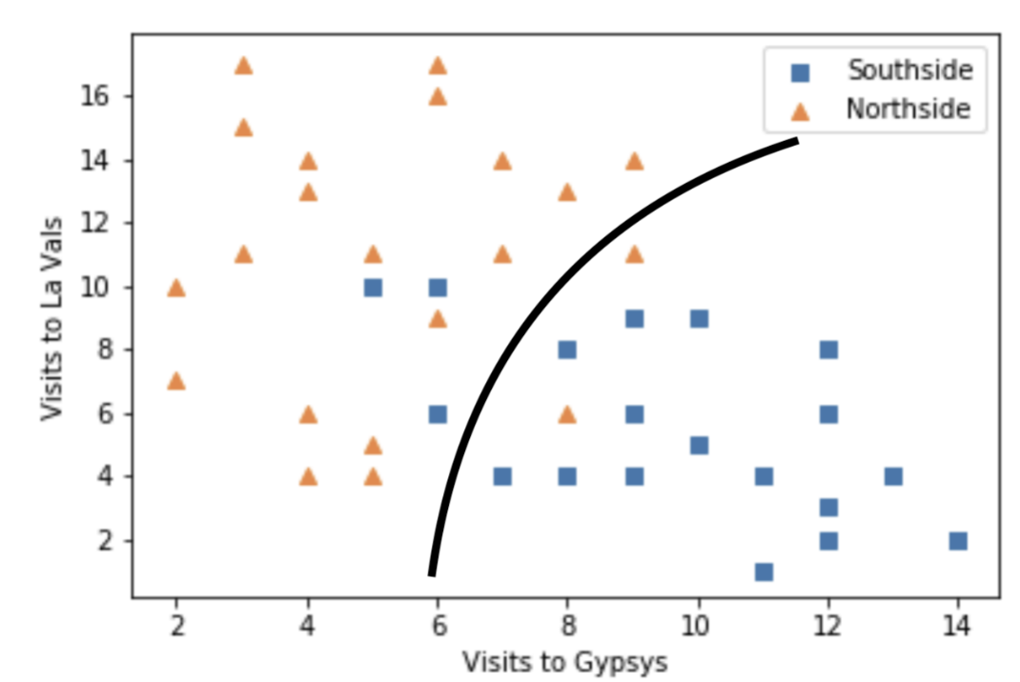
Decision Boundaries
A student is building a classifier to classify Berkeley students as residents of Northside or Southside. For each student has data on whether the student lives on Northside or Southside, the number of times the student went to La Val’s (on Northside) in the last 6 months, and the number of times the student went to Gypsy’s (on Southside) in the last 6 months. Draw a decision boundary for a 5 nearest neighbor classifier on the scatter plot below.

